Slide 1

Company Research

Slide 2

Why should I research the company?
Shows that you prepared.
Shows initiative.
Get details about culture and environment.
Helps you prepare questions.
Answers: “Why are you interested in the working at this company?”

Slide 3

When to research a company?
-Before you have a scheduled interview with Hiring Manager or Client.
-Before you accept an offer.

Slide 4

What do you need to know that would help you decide?
The work
Technologies
Team: connect with someone on LinkedIn to find out what the team is like
Supervisor
Culture: research online or ask a current employee
Management style – can be researched only by talking to a team member
Professional development and advancement – might be listed on a career page or asking an employee

Slide 5

Gather information
Company website- “About Us” section, blog, newsletter, etc.
LinkedIn
Google company name and select “News”
Friends who work there
Check “Glassdoor” or review site
Check company’s social media pages
Check out the competition
Note: Research the Interviewer on LinkedIn and connect the person to your network.
Notes:
If you see negative reviews:
Good approach: "Can I ask about the company's approach to work-life balance? I came across quite a few negative reviews on Glassdoor that noted crushing workloads, and a necessity to work on weekends to get the job done. I ask about this because I have to consider the needs of my family with accepting a position at a company."
Bad approach: "I read on Glassdoor that you guys basically demand people work 10-hour workdays. Is that true?"

Slide 6
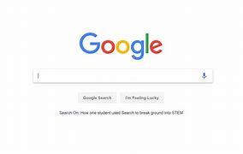
Do a Search For:
Company + Mission and Vision Statement
Company Core + Values

Slide 7
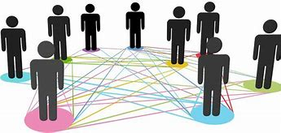
Formula for answering: “What do you know about our company?”
What it is + Why I’m impressed = Conclusion of how this connects to my values or my vision for a work environment.
• Don’t just give a list to prove you did research!
• Pick 2-3 things that impress you and make you want to work for that company.
• Tell them precisely what it is and why it is important to you.
• This question allows you to show your personality and your personal connection to the company.

Slide 8

Topic Suggestions
Reputation – company’s or the products
Values – like your own
Company culture – What is written – imagining yourself working for a company that…
A friend works there and speaks highly of the culture

Slide 9
Some examples:
“I read on your website that you’re one of the top data security companies in the US, and that you serve more than 40 Fortune 500 companies including some of the biggest tech companies like Microsoft and IBM. I also read a recent news article that mentioned you’re looking to expand into providing these services for financial institutions as well.”
“I saw in the news that you are working on improving the tire management system using Halo Connect (automatic tire inflation for tractors and trailers). I was really impressed with the over 90% reduction in need for emergency roadside assistance. I really connected with the mission to ”change the world, one revolution at a time.”

Slide 10
"I know and love the fact that the company was founded in 1994 by a woman, Barbara Brown. I feel a real connection to the mission and values of this company, and I am so impressed by how much it has grown over the last several years. The work that you did for Monroe was so innovative yet heartfelt and I knew as soon as I saw it that I wanted to be a part of the creative team here. I was really glad to see that your work on that campaign was recognized with an ADDY this past year.“
"I really respect your company's commitment to be constantly evolving. I think that growth and innovation are key in any industry but especially in the field of technology, and this organization is constantly pushing past the preconceived limitations. In this past year alone you have taken quite a few risks as you are entering different markets, all of which have paid off. As an engineer, I strive to approach problems in new and creative ways, which is why I think I would be an asset to this team."

Slide 11
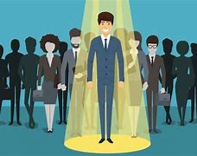
Conclusion statement (not mandatory but helps)
At the end:
Explain how your qualifications and experience can add to the published mission of the business within the department you are applying.
Or Connect to any recent technology news related to the Job description
Or connect with TED talks from a founder or senior member
The Goal is to show you are the best fit for this job.

Slide 12
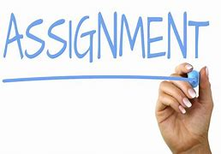
Complete Company Research and Demo form

Slide 13
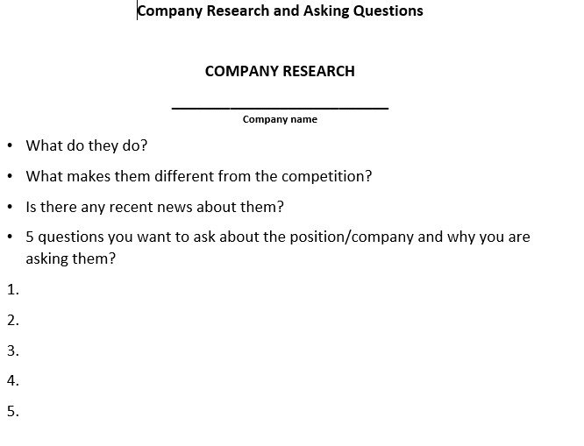
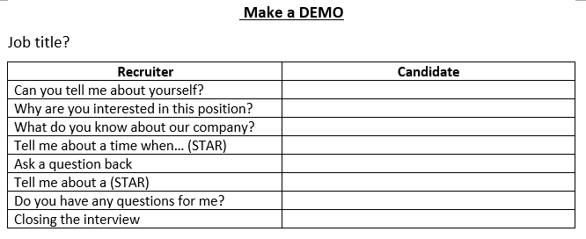
Demonstrate your Skills
You’re going to research a company where you found your job description.
Complete these forms with your research.

